Slide 1
Tips on how to minimize the risk of personal data breach

Slide 2
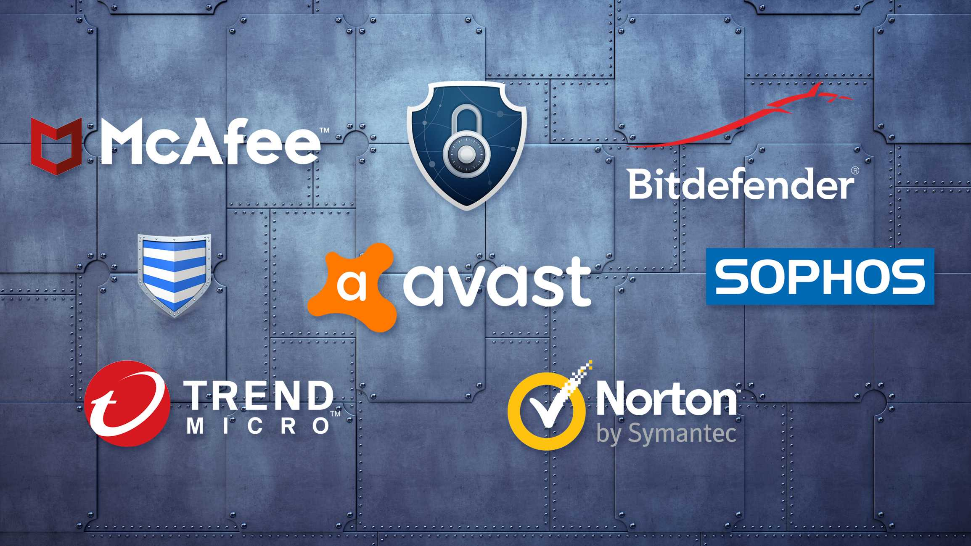
Ensure up-to-date Antivirus and Anti-Malware Software

Slide 3
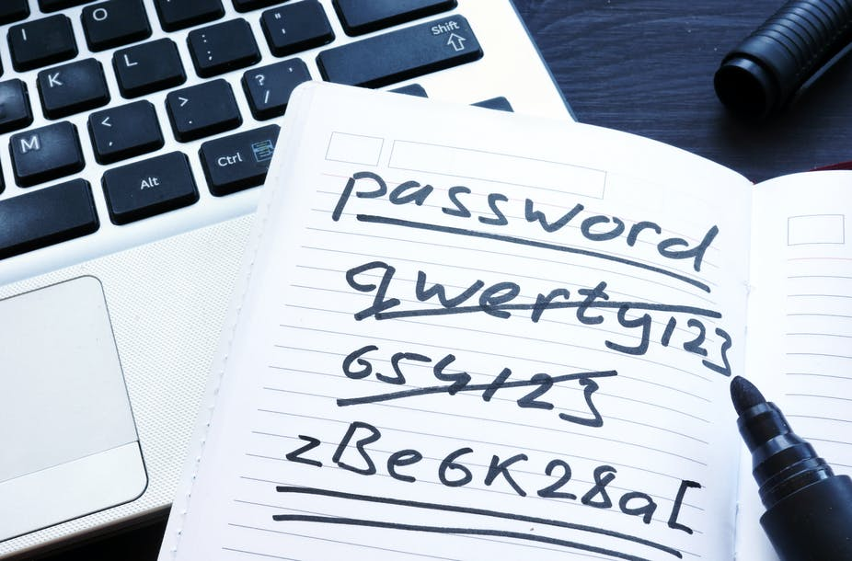
Do not share your login credentials to anyone

Slide 4
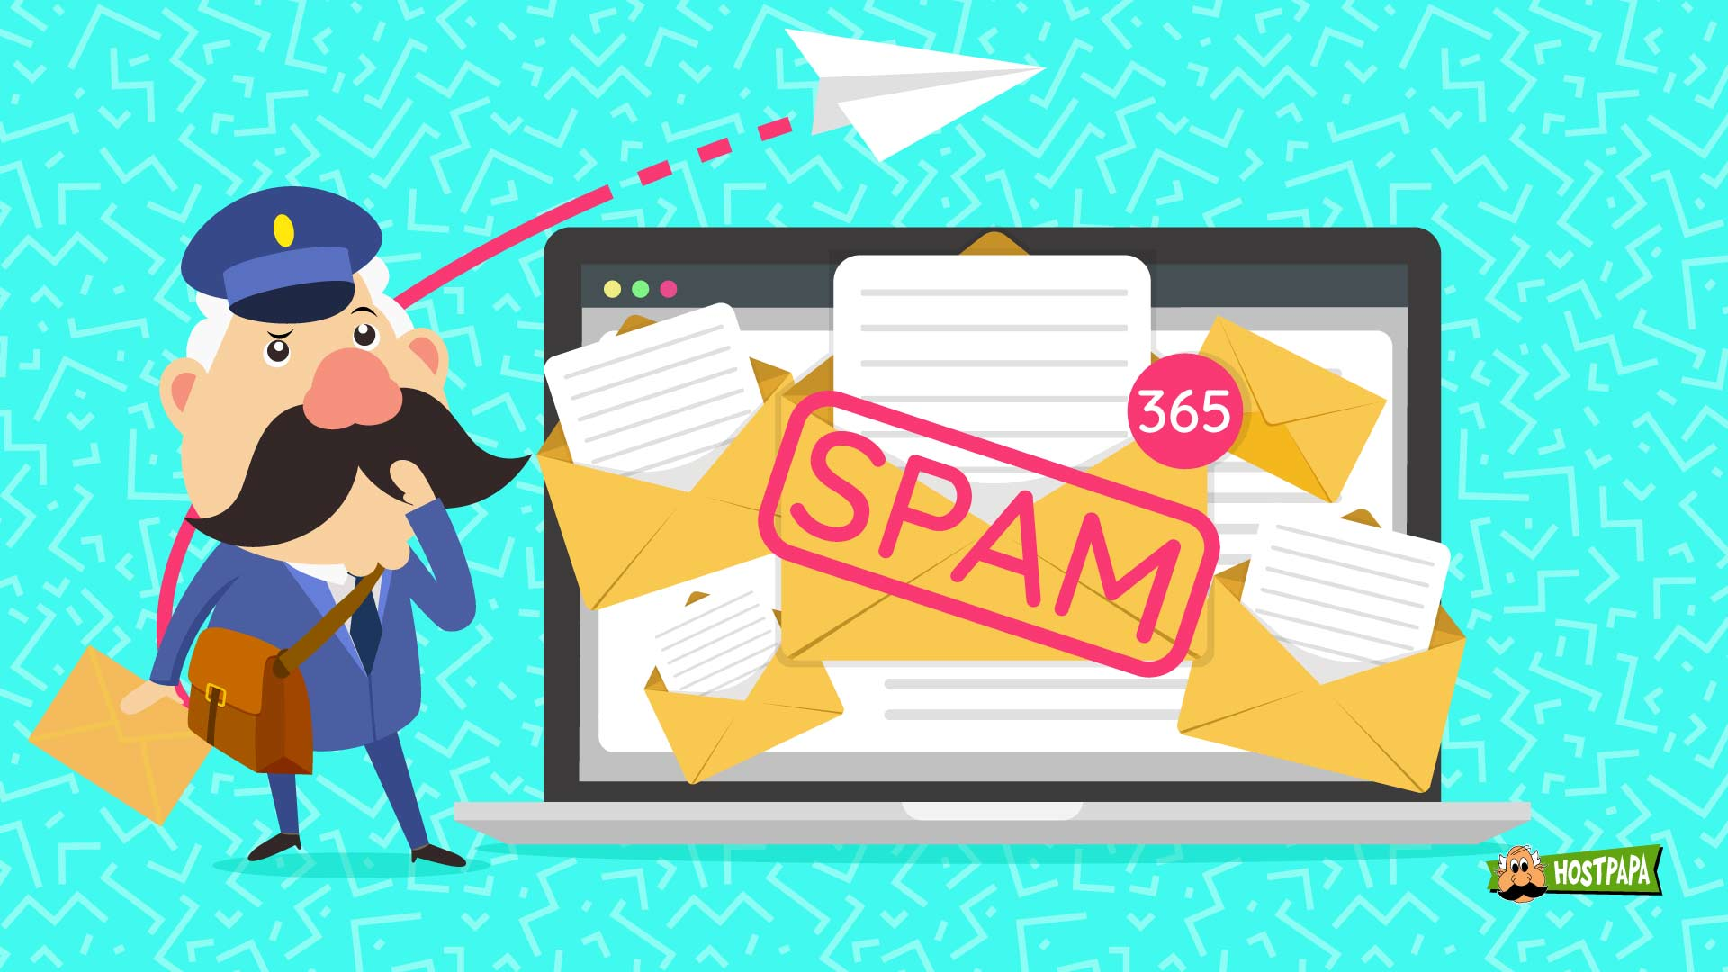
Beware of e-mails from unknown sources

Slide 5
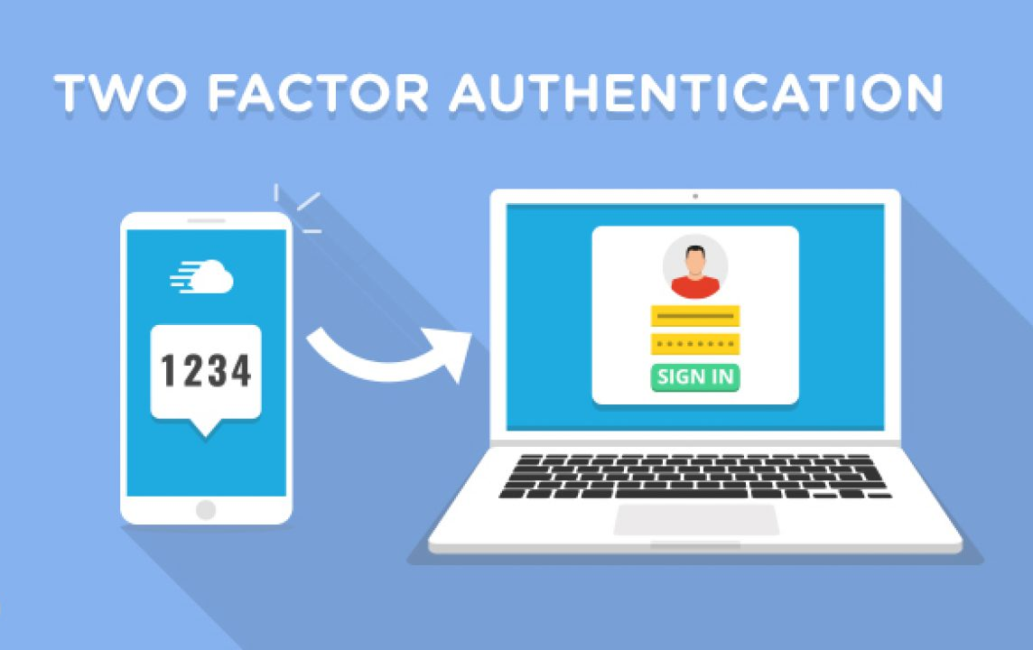
Enable 2-Factor Authentication

Slide 6
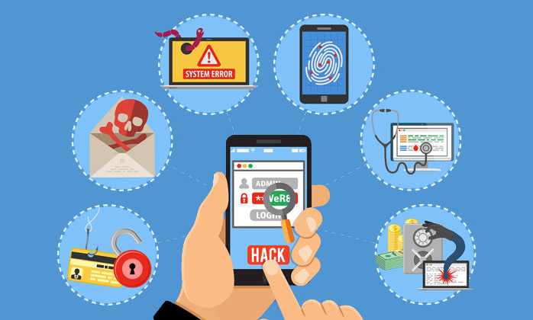
Be careful with Social Engineering attacks

